Slide 1

Today’s Contents
Image Sensing and Acquisition
Visual Perception
Image Formation
Image Acquisition
Image formation model
Chapter 2 from R.C. Gonzalez and R.E. Woods, Digital Image Processing (3rd Edition), Prentice Hall, 2008 [ Section 2.1, 2.2, 2.3 ]
2019/1/13
2

Slide 2
What is meant by visual perception?
Visual perception is the ability to see and interpret (analyze and give meaning to) the visual information that surrounds us.
There is a large difference between the image we display and the image we actually perceive.

Slide 3

Human Visual System
There is a difference between the luminance of a pixel on a computer screen and the perceived brightness of this pixel.
If we double the screen luminance, this does not imply that the perceived brightness is doubled too.
The brightness also depends on other factors, such as contrast around the pixel and various cognitive processes
Notes:
Every RGB pixel computes to a 8 bit Luminance value between 0 and 255 (because 0.3 + 0.59 + 0.11 = 1.0).

Slide 4
Human Visual System
The human visual system can perform a number of image processing tasks in a manner vastly superior to anything we are presently able to do with computers.
The best vision model we have!
If we want to mimic such processing, we need to carefully study the way our eyes and brain do this.

Slide 5
Human Visual System
The human visual
system consists of two
functional parts:
eye and
(part of the) brain.
The brain does processing, while
all of the complex image the eye functions as the
biological equivalent of a camera.

Slide 6
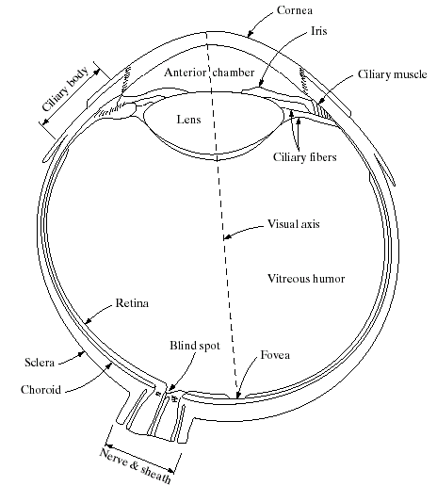
Structure Of The Human Eye
The lens focuses light from objects onto the retina
The retina is covered with
light receptors called cones (6-7 million) and rods (75-150 million)
Cones are concentrated around the fovea and are very sensitive to colour
Rods are more spread out
and are sensitive to low levels of illumination

Slide 7
When a light ray hits the eye, it will first pass through the cornea, then subsequently through the aqueous humor, the iris, the lens, and the vitreous humor before finally reaching the retina.
The cornea is a transparent protective layer, which acts as a lens and refracts the light.
The iris forms a round aperture that can vary in size and so determines the amount of light that can pass through.
In the retina, the light rays are detected and converted to electrical signals by photoreceptors.

Slide 8
Visual Perception: Human Eye
The lens contains 60-70% water, 6% of fat.
The iris diaphragm controls amount of light that enters the eye.
Light receptors in the retina are Cones and Rods:
Cones for bright light vision called photopic
Cones involve in color vision.
Cones are concentrated in fovea about 1.5x1.5 mm².
Rods for dim light vision called scotopic
Rods are sensitive to low level of light and
are not involved in color vision.
Blind spot is the region of emergence of the optic nerve from the
eye. In this area receptors are absent and no image detection.

Slide 9
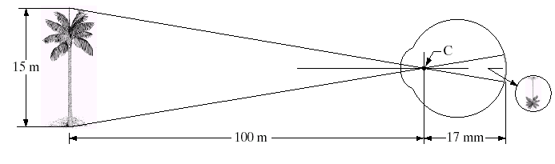
Image Formation In The Eye
Muscles within the eye can be used to change the shape of the lens allowing us focus on objects that are near or far away
An image is focused onto the retina causing rods and cones to become excited which ultimately send signals to the brain
(Height of the tree in the retinal image ) / 17 = (15/100 )
Notes:
The geometry in Fig. illustrates how to obtain the dimensions of an image formed on the retina. For example, suppose that a person is looking at a tree 15 m high at a distance of 100 m. Letting h denote the height of that object in the retinal image, the geometry of Fig yields 15/100 = h/17 or h = 2.55 mm.

Slide 10


Some psychophysics:
Blind-Spot Experiment
Draw an image similar to that below on a piece of paper (the dot and cross are about 6 inches apart)
Close your right eye and focus on the cross with your left eye
Hold the image about 20 inches away from your face and move it slowly towards you
The dot should disappear!

Slide 11
Brightness Adaptation & Discrimination
The human visual system can perceive approximately 10¹⁰ different light intensity levels
However, at any one time we can only discriminate between a much smaller number – brightness adaptation
Similarly, the perceived intensity of a region is related to the light intensities of the regions surrounding it

Slide 12
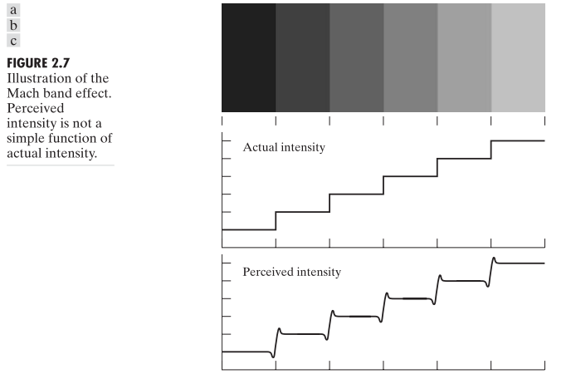
Brightness Adaptation & Discrimination
Intensities of surrounding points effect perceived brightness at each point.
In this image, edges between bars appear brighter on the right side and darker on the left side.
Notes:
Two phenomena clearly demonstrate that perceived brightness is not a simple function of intensity. The first is based on the fact that the visual system tends to undershoot or overshoot around the boundary of regions of different intensities. Figure 2.7(a) shows a striking example of this phenomenon. Although the intensity of the stripes is constant, we actually perceive a brightness pattern that is strongly scalloped near the boundaries [Fig. 2.7(c)]. When we go from left to right(i.e. darker to lighter), our perceived intensity rises slightly around the edge and then becomes constant, the opposite happens too when we go from right to left (i.e. lighter to darker)
These seemingly scalloped bands are called Mach bands after Ernst Mach, who first described the phenomenon in 1865.

Slide 13

Mach Band Effect (Cont)
A
B
Ernst Mach described this phenomenon in 1865
Intensity
Position
In area B, brightness perceived is darker while in area A is brighter.
This phenomenon is called Mach Band Effect.
Notes:
From the previous slide’s graph we can see that actual intensity rises steeply, but our perceived intensity can differentiate at wider ranges. Look closely here, we can see that we can differentiate even the small intensity numbers.

Slide 14
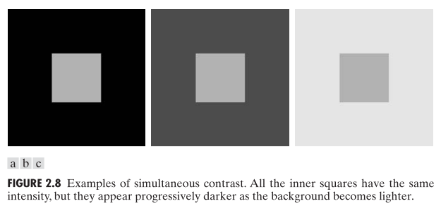
Brightness Adaptation & Discrimination (cont…)
Notes:
The second phenomenon, called simultaneous contrast, is related to the fact that a region’s perceived brightness does not depend simply on its intensity, as Fig. 2.8 demonstrates. All the center squares have exactly the same intensity.
However, they appear to the eye to become darker as the background gets lighter. A more familiar example is a piece of paper that seems white when lying on a desk, but can appear totally black when used to shield the eyes while looking directly at a bright sky.

Slide 15

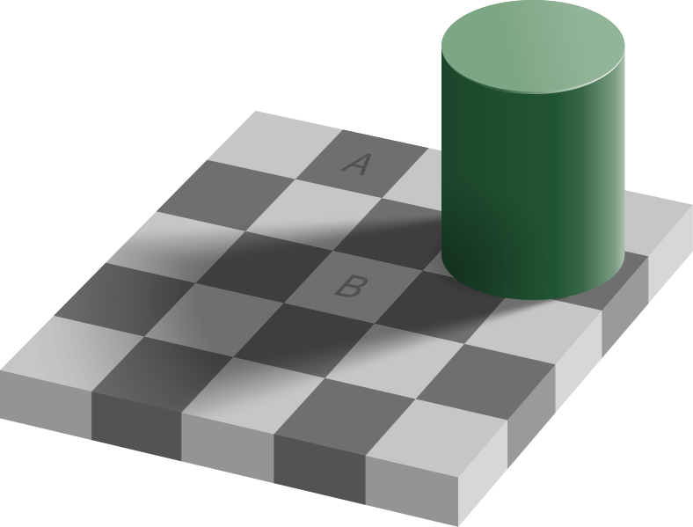
Optical Illusions
Does A & B represents same luminance?

Slide 16
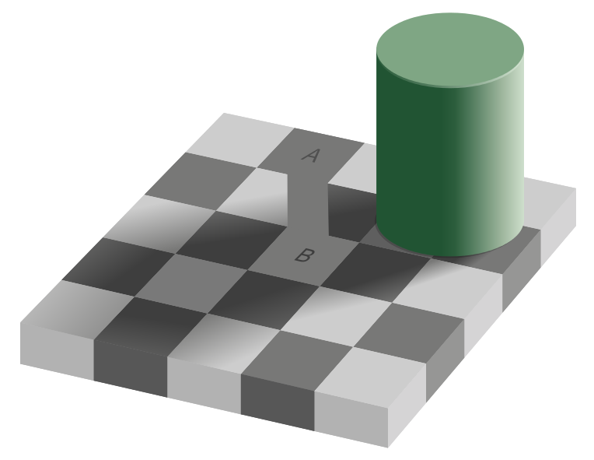
Optical Illusions
The checker shadow illusion. Although square A appears a darker shade of gray than square B, in the image the two have exactly the same luminance.[Wikipedia]

Slide 17
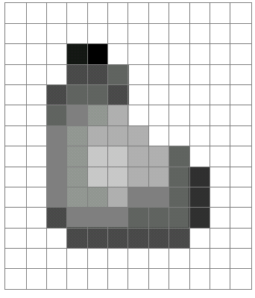
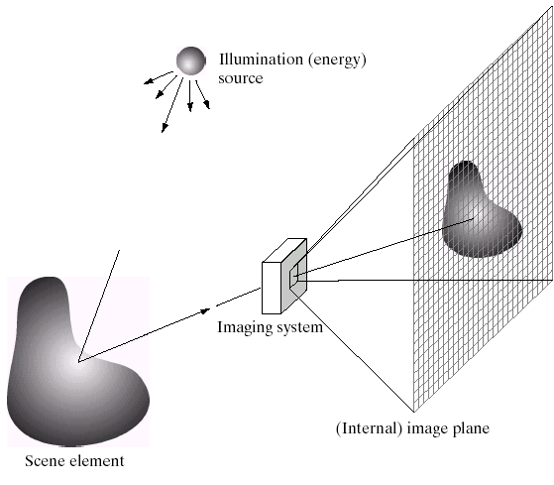
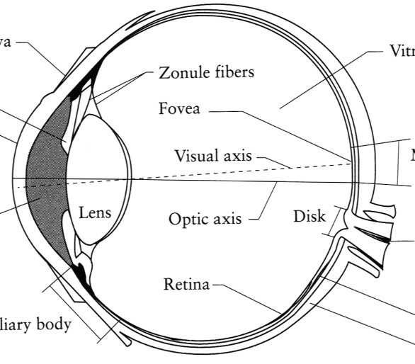
Image Formation
Digital Camera
Film
The Eye

Slide 18
In the following slides we will consider what is involved in capturing a digital image of a real-world scene
Image sensing and representation and acquisition
Sampling and quantisation
Resolution

Slide 19

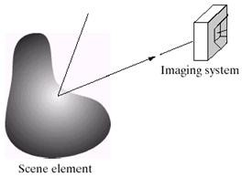
Image Acquisition
Three main elements
Illumination source
Scene
Sensor (imaging system)

Slide 20
Image Acquisition
Illumination source:
Can be light energy or
EM spectrum
Even less tradition sources like
Sound, heat
Scene:
Any object: visible or hidden
Source itself
Sensor:
Should be capable of sensing the energy

Slide 21
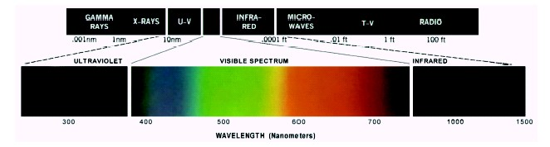
Light And The Electromagnetic Spectrum
In 1666 Sir Isaac Newton discovered that sunlight passed through a prism splits into a continuous spectrum of colors
Light is just a particular part of the electromagnetic
spectrum that can be sensed by the human eye
The electromagnetic spectrum is split up according to the wavelengths of different forms of energy

Slide 22
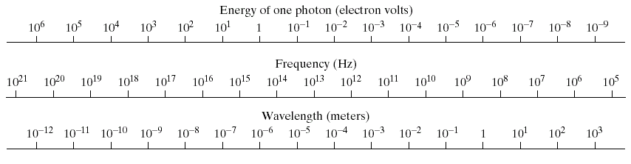
A discrete bundle (or quantum) of electromagnetic (or light) energy,
PHOTON is proportional to frequency.

Slide 23
A photon's life choices
Absorption
Diffusion
light source
Reflection
λ
Transparency
Refraction
Fluorescence
?
Subsurface scattering
Phosphorescence
Interreflection
Chapter 2 of Szeliski

Slide 24



A photon’s life choices
Absorption
Diffusion
Reflection
Transparency
Refraction
Fluorescence
Subsurface scattering
Phosphorescence
Interreflection
light source
λ

Slide 25
A photon’s life choices
Absorption
Diffuse Reflection
Reflection
Transparency
Refraction
Fluorescence
Subsurface scattering
Phosphorescence
Interreflection
light source
λ

Slide 26
A photon’s life choices
Absorption
Diffusion
Specular Reflection
Transparency
Refraction
Fluorescence
Subsurface scattering
Phosphorescence
Interreflection
light source
λ

Slide 27
A photon’s life choices
Absorption
Diffusion
Reflection
Transparency
Refraction
Fluorescence
Subsurface scattering
Phosphorescence
Interreflection
light source
λ

Slide 28
A photon’s life choices
Absorption
Diffusion
Reflection
Transparency
Refraction
Fluorescence
Subsurface scattering
Phosphorescence
Interreflection
light source
λ

Slide 29
A photon’s life choices
Absorption
Diffusion
Reflection
Transparency
Refraction
Fluorescence
Subsurface scattering
Phosphorescence
Interreflection
light source
λ₁
λ₂
Notes:
Emission of light by a substance(the surface here) that has absorbed light or other electromagnetic radiation.

Slide 30
A photon’s life choices
Absorption
Diffusion
Reflection
Transparency
Refraction
Fluorescence
Subsurface scattering
Phosphorescence
Interreflection
light source
λ
Notes:
A mechanism of light transport in which light that penetrates the surface of a translucent/semi-transparent object (e.g. human face) is scattered by interacting with the material and exits the surface at a different point.

Slide 31
A photon’s life choices
Absorption
Diffusion
Reflection
Transparency
Refraction
Fluorescence
Subsurface scattering
Phosphorescence
Interreflection
light source
t=1
t=n
Notes:
When exposed to light of a shorter wavelength, a phosphorescent substance will glow, absorbing the light and reemitting it at a longer wavelength.

Slide 32
A photon’s life choices
Absorption
Diffusion
Reflection
Transparency
Refraction
Fluorescence
Subsurface scattering
Phosphorescence
Interreflection
light source
λ
(Specular Interreflection)
Notes:
The illumination of an object by reflected light from other objects that are not light sources.

Slide 33
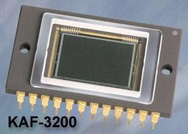
Image Sensors
Incoming energy lands on a sensor material responsive to that type of energy and this generates a voltage
Collections of sensors are arranged to capture images
Charge-Coupled Device (CCD)
Used for convert a continuous image into a digital image
Contains an array of light sensors
Converts photon into electric charges accumulated in each sensor unit
CCD KAF-3200E from Kodak.
(2184 x 1472 pixels, Pixel size 6.8 microns²)

Slide 34
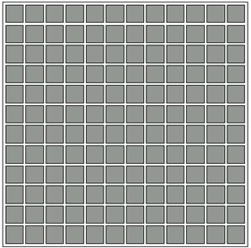
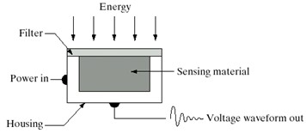
Image Sensors used to transform illumination energy to digital images.
3 main sensor arrangements:
Single sensor
Line sensor
Array sensor
Single sensor
Array sensor
Line sensor
Sensing element can be a photodiode
Filter absorbs extra energy or acts as pass-band
Notes:
Figure shows the three principal sensor arrangements used to transform illumination energy into digital images. The idea is simple: Incoming energy is transformed into a voltage by the combination of input electrical power and sensor material that is responsive to the particular type of energy being detected. The output voltage waveform is the response of the sensor(s), and a digital quantity is obtained from each sensor by digitizing its response.

Slide 35
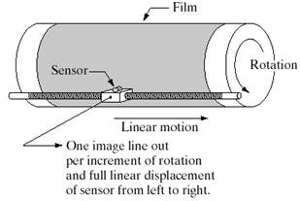
Image Acquisition using Single Sensor
can image only a particular point
Requires mechanical movement in both direction
High special resolution is possible in both direction
Notes:
In order to generate a 2-D image using a single sensor, there has to be relative displacements in both the x- and y-directions between the sensor and the area to be imaged. Figure 2.13 shows an arrangement used in high-precision scanning, where a film negative is mounted onto a drum whose mechanical rotation provides displacement in one dimension. The single sensor is mounted on a lead screw that provides motion in the perpendicular direction. Because mechanical motion can be controlled with high precision, this method is an inexpensive (but slow) way to obtain high-resolution images

Slide 36
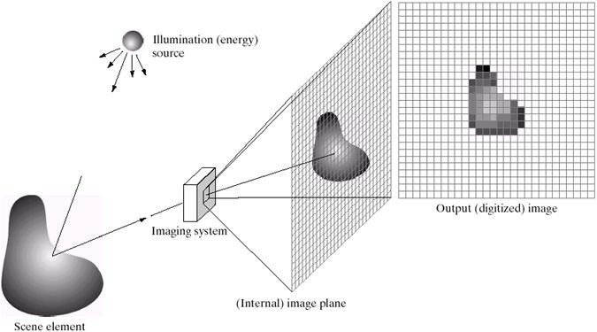
Image Acquisition using Sensor Array
Images are typically generated by illuminating a scene and absorbing the energy reflected by the objects in that scene.

Slide 37
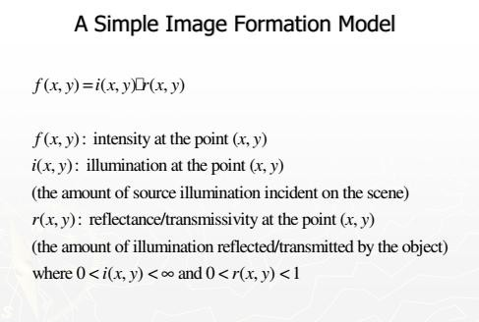

Notes:
The function f(x, y) may be characterized by two components:
the amount of source illumination incident on the scene being viewed i(x,y), and
the amount of illumination reflected by the objects in the scene r(x,y).
Appropriately, these are called the illumination and reflectance components and are denoted by respectively. The two functions combine as a product to form f(x, y)

Slide 38
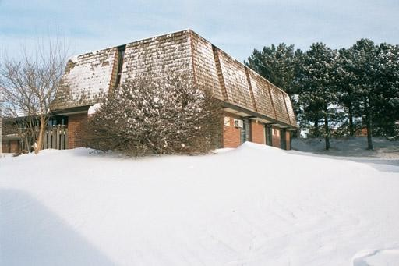
Image Formation Model
x
Origin
0 < f (x, y) < α
y
f(x,y)
Image “After snow storm”
An image: a multidimensional function of spatial coordinates.
Spatial coordinate:
(x,y) for 2D case such as photograph, (x,y,z) for 3D case such as CT scan images (x,y,t) for movies
The function f may represent intensity (for monochrome images) or color (for color images) or other associated values.

Slide 39

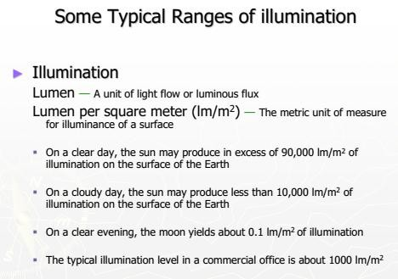

Slide 40
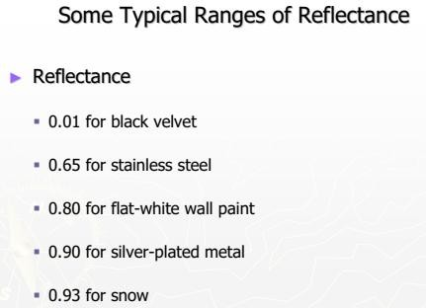
Notes:
Reflectance r(x,y) is bounded by 0 (total absorption) and 1 (total reflectance).

Slide 41
Thank you

